Slide 1

Test Data Management
TDM

Slide 2
Data Types
Static Data - Data that doesn't change after being recorded. Data points such as names and addresses are not considered dynamic. Most static data comprise non-sensitive information, but it can also include banking details and other credentials in some cases.
Dynamic Data - Test data that is constantly evolving and needs to be updated regularly is called dynamic data. Example: information such as banking and transaction history. Since dynamic data is the most sensitive, ensuring adequate storage and security is essential.

Slide 3
Test Data Challenges
Slow, Manual test environment provisioning
Increased Storage Cost
Data Availability
Data Accessibility
Data Quality
Corrupted data
Irrelevant or incomplete data
Unmasked data
Generic Data

Slide 4
What is TDM
TDM is a process of sourcing, managing and delivering high quality test data to the testing teams as and when required; it should be compliant, secure
With TDM, organizations can ensure that testers always have access to quality data in the required formats and the right quantities to fulfill their testing requirements.
Since handling production data can be challenging due to its sensitivity and volume, many companies have also integrated data synthesis and obfuscation into their TDM practices.
Based on the use cases and type of test, both static and dynamic data are used together. This data needs to be identified, sourced, and brought in from different databases while maintaining its integrity. It also needs to be securely stored and managed to avoid regulatory issues.

Slide 5
TDM Processes
Plan
Design
Source
Store
Secure
Retrieve

Slide 6
TDM Workflow
Analysis of test data requirements
Obfuscation and Masking of data
Subsetting of data
Generation of required data
Delivery of data

Slide 7
TDM Framework
Enterprise Data Strategy
Data Principles
Data Cloning/Sampling
Synthetic Data Creation
Data Achieve and Maintenance
Delivery Management

Slide 8
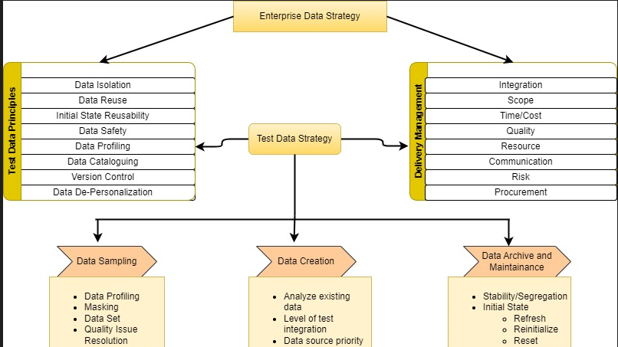

Slide 9
TDM Strategy
Reactive Strategy
Test Case driven.
When the application is already built and testing team have access of application, Test cases defining business flows are created and full testing requirements are defined by test manager, but testers don’t have test data to test the flows.
Testers react to application/test cases and start creating test data to fit into test case.
By this time nobody is sure on what data they need and starts reacting to test cases and may run into data issues.
Proactive Strategy
Application is not built.
It is Business rules driven.
Having Rule Based Engine that will create business rules.
Should be able to synthetically create test data which is compliant with the set of business rules.
The testing needs to be against the set of business rules using compliant data.
Having rule-based data in the test environment and testing it to break the business rules provides better test results.
Even if the application is not built but the tester is aware of the business rules and the sort of test data, he must use will give a better edge in testing the flows.

Slide 10
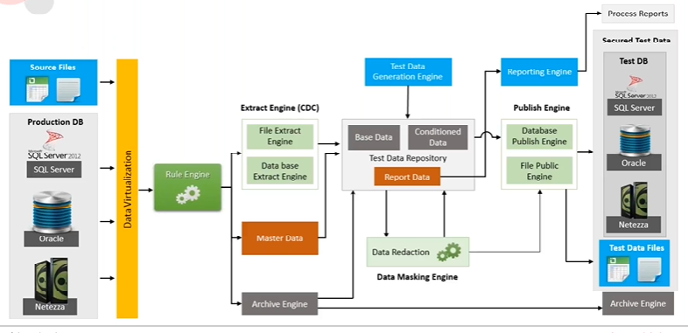

Slide 11
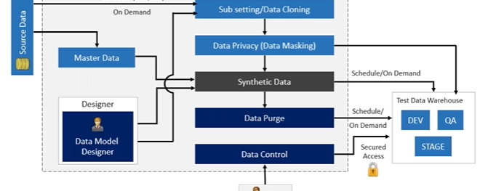
Test Data Generation Engine

Slide 12
Production Vs Synthetic Data – When to use what ?
Speed
What are time requirements
Cost
What is acceptable cost to create and maintain data
Security
What are privacy implications and security protocols
Quality
What are important data quality factor
Availability
Is getting required test data easy
Versatility
Can the test data be used by testing tools and technologies

Slide 13
Case Study
Challenge
A large payment client required a solution to accelerate the agility, efficiency and compliance for its data generation process.
Involvement of DBA required when moving data to lower environment for testing leading to delays in testing cycle’s
Number of invalid defects and insufficient test coverage due to incorrect or insufficient test data
There is often a need to generate data based on requirements before ETL development is complete, when development is going on in parallel for Reports and ETL
Manual process which needs to be repeated for different environments.
Solution
Creation of data model using cloning process.
Capture, Create, Store and Manage test data to share and reuse
Automatically generate test data
Accelerate development testing lifecycle
Results
Increase efficiency in testing process.
Mitigate risk of exposure to sensitive data.
Reduce costs associated with testing.

Slide 14
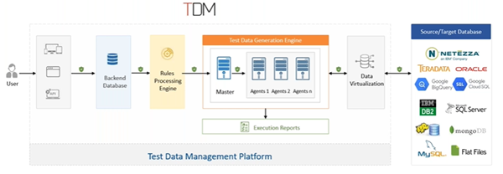
TDM Architecture

Slide 15
TDM Advantages
Better test coverage
Increased cost savings
Improved customer satisfaction
Faster time-to-market

Slide 16
TDM Tools
Plugins/Libraries
Bugmagnet extension for chrome
Autotestdata.com
mockaroo.com
Faker
databucket-server
TDSpora
Generatedata
Datafactory/data-factory
DataGenerator
mockneat
Commercial Tools
K2view Test Data Management
Broadcom Test Data Manager
IBM InfoSphere® Optim™ Test Data Management
Informatica Test Data Management
Delphix Test Data Management
Datprof Test Data Management Solution

Slide 17
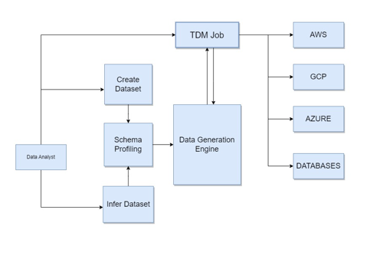
Synthetic Data Generation using Datamaker software

Slide 18
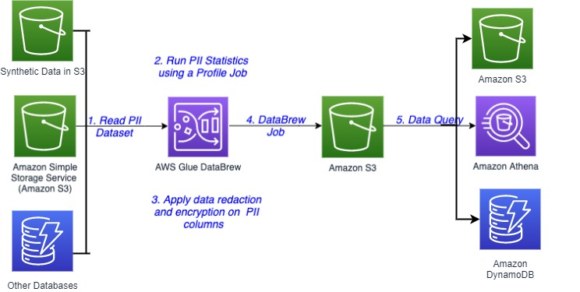
AWS Glue DataBrew Service for TDM

Slide 19

Q & A

